Slide 1

Scoping and refining requirements
This work is licensed under the Creative Commons Attribution 2.5 UK: Scotland License.
Notes:
Now that we’ve set the scene for today. We’ll get started on thinking about scoping and refining user requirements.
Without a solid understanding of what users want, it is impossible to develop services that will be used and valued. For the next 20 minutes, we’ll share some tips on how to start assessing user requirements at your institution. We’ve distilled key points from our How to Develop RDM
Services and How to Discover Requirements for Research Data Management Services guides – both are included in your packs so that you can delve into these in more detail once you return home.

Slide 2

Establish a working group
Good mix of representatives from operational units
Senior management leadership
http://www.executive-coaching-services.co.uk/executive-coaching/leaders.jpg
Notes:
A steering group’s overall goals may include establishing policy principles for RDM, to help communicate where it fits within the organisation’s overall mission, and to define the roles and responsibilities outlined in this guide. The steering group will also devise a strategy or roadmap for high-level approval, considering the institution’s research strategy, external policy drivers, service priorities and technology opportunities. The steering group’s overall goal will be to identify a business case to be presented to whichever organisational body can commit funding towards establishing the necessary services.
It is important to get a good mix of representation from operational units on the working group or steering committee. Representatives from the Library, Research Office, and Information Technology Services are quite common. However, it is good to ensure that you also get representation from:
Ethics Boards to ensure that plans for retaining and sharing data can be recognised within consent forms;
Data Protection/FoI to ensure that expertise on relevant exceptions to data sharing where necessary;
Legal or IPR office staff to ensure that appropriate consortium agreements can be drawn up for collaborations with industry and that appropriate licences can be identified for research output that respect any future plans for commercialisation;
Finance staff to ensure that costing RDM can be effectively addressed in grant applications.
We’d also recommend involving someone from the Archives and/or Records Management. In the UK, they have tended to be overlooked but have a great wealth of knowledge to contribute around retention scheduling, selection and appraisal.
We’ve also found that it may also be beneficial to involve members from different Schools or Faculties to ensure that disciplinary requirements are represented.
However, you may find that not all members need to be involved at all stages. You may start small to get things moving and seek to bring in other stakeholders at relevant points in the process. However, it is advisable to bring in stakeholders before pilot services are developed to ensure that they feel they are part of the process and not simply having solutions forced upon them.
Ideally a member of the senior management group responsible for research should chair the group from the start (e.g. the Vice President or Pro Vice Chancellor for Research). Indeed, it may be a good idea to get more than on senior manager’s backing as it can be quite difficult to maintain momentum of the group if the Pro-VC leaves for any reason. We have seen a few cases where this ha happened in the UK and it can derail activity quite badly if the new Pro-VC doesn’t see RDM as a key issue.

Slide 3

Assess institutional context
Number of active researchers
Aspirations and strategic objectives
http://www.drewsmarketingminute.com/images/2014/09/Creating-A-Company-Culture.jpg
Notes:
Start by assessing your institutional context.
It is important to scope the institutional context, to explain and agree why RDM services are needed, to understand what specific challenges the services are expected to resolve and what, essentially, such services should deliver - See more at: http://www.dcc.ac.uk/resources/how-guides/how-develop-rdm-services#Process
Before anything else, you should be aware of number of active researchers at your institution (are you research intensive or not)? Perhaps your institution is more targeted toward learning and teaching than research. You can normally get this sort of information from your research office.
If your institution is not currently research intensive, consider what level of service you really need – i.e., the service should be fit for purpose. However, also be aware of whether targets for increase in number of active researchers is a strategic objective for your organisation. If so, then you may justify a service above what is currently needed.
Also work with you research office to analyse where your research income currently comes from. Are there specific funders that emerge? What are their expectations? Where would your organisation like to secure funding in the future? Again, be aware of institutional strategic objectives. This sort of information can usually be found in University strategies and policies. But also think about College and/or School level strategies and policies.
More on Jonathan next about getting the balance of services right.

Slide 4
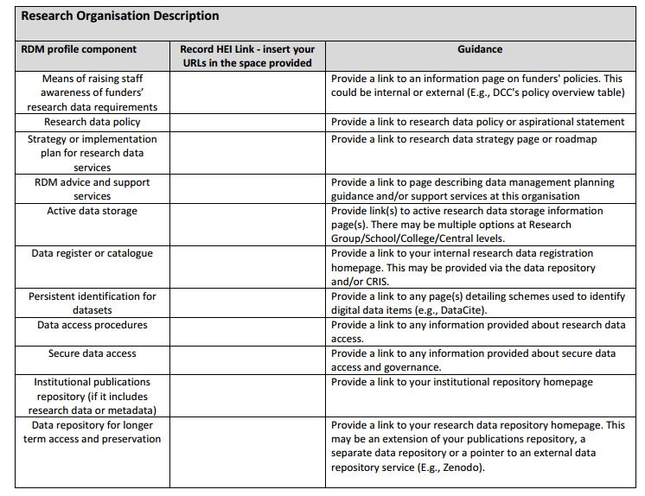
Be aware of existing infrastructure
http://www.dcc.ac.uk/projects/opd-for-rdm
Notes:
It is a good idea to start by undertaking an inventory of your current RDM infrastructure. It is important to be clear here that infrastructure refers to hardware and technical solutions but also to the range of policies, guidance, training and support that are provided within an institution.
Without a clear picture of the infrastructure components already in place and additional components that need to be implemented, it is
likely that inefficiencies or duplication of effort may result when developing RDM services.
We developed a basic RDM profile worksheet and guide as part of the Jisc RDS pilot to extend the Organisational profile Document to cover RDM. The key objective of the RDS pilot project was to agree within the RDM community a list of basic RDM infrastructure components in light of RCUK’s Common Principles on Data Policy and specifically the Engineering and Physical Sciences Research Council (EPSRC) Policy Framework on Research Data and to make these infrastructure components more visible and easier to identify. The first phase of the pilot project ran from March to July 2015. A second phase of the project worked to flesh out a list of questions that HEIs can answer to get a better insight into how they are delivering specific infrastructure components. The second phase ran from September to December 2015.
By developing your own basic RDM profile, you’ll have a better understanding of what infrastructure is in place and how individual components are currently being delivered.
The basic RDM profile should not require much effort to complete. DCC have been using this as a starting point in our engagements recently and it can usually be completed in about half an hour of browsing an institution’s web site. In some cases, resources are restricted to staff only access, but the inventory helps to highlight just how easily services and infrastructure can be found – not necessarily accessed - when a potential customer is looking for it. Some quick wins can be made based on this inventory such as making services more visible and linking to them from more relevant pages that researchers might visit (e.g., not always best to include in the Library pages but rather research pages).

Slide 5

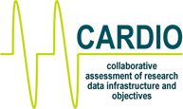

How to discover requirements
Surveys
Interviews
Case studies
Workshops
http://www.dcc.ac.uk/resources/tools/data-asset-framework
http://www.dcc.ac.uk/resources/tools/cardio
Notes:
Many institutional RDM projects benefit from online surveys of researchers and other stakeholders in data management. These typically draw on similar questions to larger scale surveys of common practices and attitudes towards data sharing and reuse. DAF (Data Asset Framework) offers a quick and lightweight approach to discovering data management practice though online and face-to-face surveys and interviews.
When surveying, consider the purpose and scope of the survey carefully (e.g. institution-wide or a specific faculty group or support function, and conducting preliminary research).
Online surveys are typically 10-20 questions covering research-active staff awareness of policy requirements, responsibilities for data management planning, expectations of benefits, needs for training and guidance, current practices for backup and storage, providing access to working data, and sharing data of longer-term value, plus their priorities for support service provision. Avoid too many questions to ensure you don’t overwhelm respondents!
Consider augmenting survey data with a few semi-structured interviews typically span a number of pilot groups, across disciplines, funding sources and scale of research teams. Studies normally involve 3-6 researchers depending on group size, from PhD students to group leaders at professorial level. The interviews cover similar topics to survey questions, but aim for a more conversational approach to understand the researchers’ current field of research and context.
Case studies of research groups’ data practices can be of great value to understanding their requirements in context, although this can also be a very time-consuming and therefore costly approach.
Workshops are also a good way to capture requirements. DCC has used our Collaborative Assessment of RDM Infrastructure and Objectives (CARDIO) tool to help identify infrastructure and gaps. A quick to use 3-page roadmap matrix provides three groups of three capabilities that describe a service in line with the RCUK common principles on research data policy. These capabilities are informed by the EPSRC data policy expectations of institutions it funds.​ The matrix can be used to structure a meeting between Library, IT and Research Support colleagues to plan a roadmap or action plan towards a live service.
CARDIO http://www.dcc.ac.uk/sites/default/files/documents/events/EPSRC-workshop/CARDIO_matrix_EPSRC.pdf

Slide 6

Prioritise requirements
What is urgent?
What can wait?
http://goalsandachievements.co.uk/images/prioritise.jpg

Slide 7

Refining requirements
Requirements change!
Plan to re-assess and refine
http://cdn2.hubspot.net/hub/129398/file-699125079-jpg/images/452070249-resized-600.jpg

Slide 8

Thanks for listening!
DCC guidance, tools and case studies:
www.dcc.ac.uk/resources
Follow us on twitter:
@digitalcuration and #ukdcc

